Slide 1
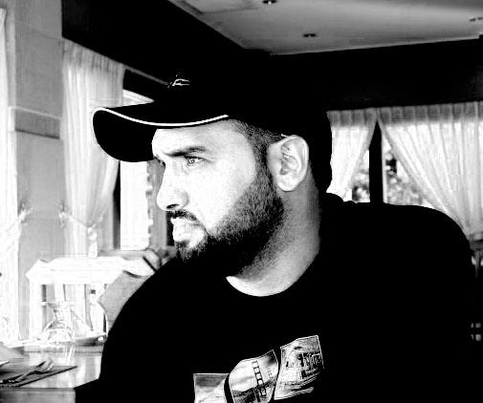
What really happens when you navigate to a URL
Abdulkarim Albanna
www.facebook.com/abdulkarimAlbanna

Slide 2
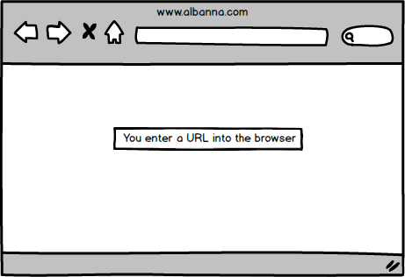
URL in Address Bar
http://www.albanna.com

Slide 3
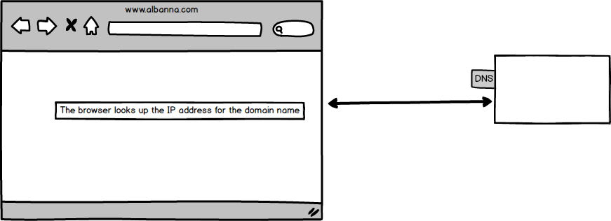
Domain Name System

Slide 4
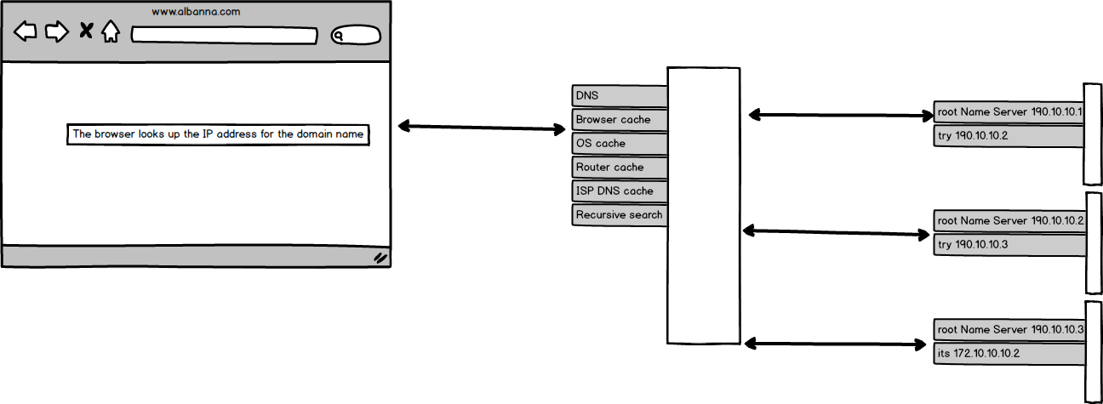
Domain Name System

Slide 5
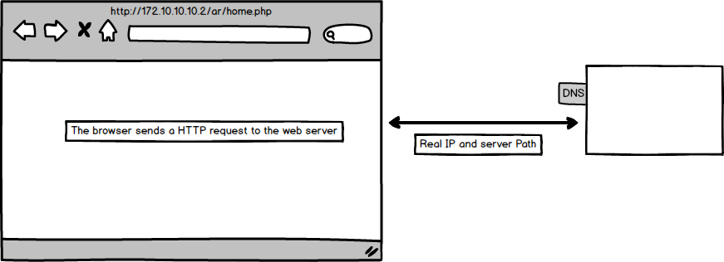
Domain Name System
ipconfig /flushdns
sudo killall -HUP mDNSResponder
sudo /etc/init.d/nscd restart

Slide 6
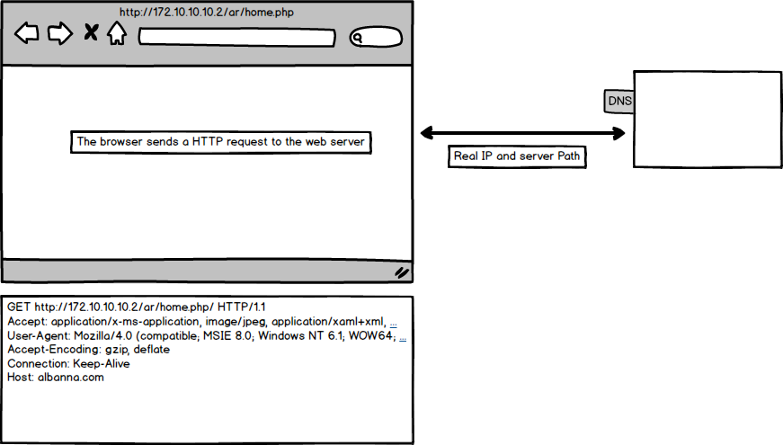
Http Request

Slide 7
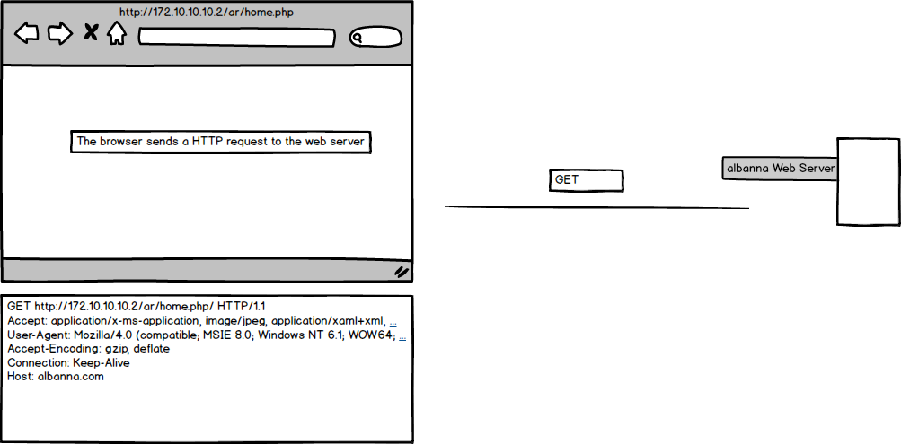
Http Request

Slide 8
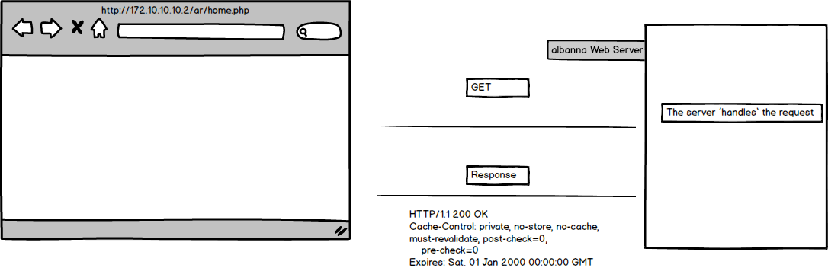
Http Response

Slide 9
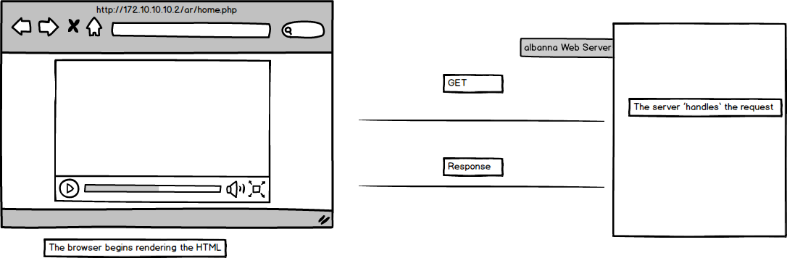
HTML Rendering

Slide 10
Next Lesson

